Slide 1
Lesson 6
How to code summary queries
Lecture adapted from Murach’s MySQL Textbooks

Slide 2
Objectives
Applied
Code summary queries that use aggregate functions, including queries that use the WITH ROLLUP operator and the GROUPING and IF functions.
Code summary queries that use aggregate window functions, including functions that use frames and named windows.
Knowledge
Describe summary queries.
Describe the differences between the HAVING clause and the WHERE clause.
Describe the use of the WITH ROLLUP operator.
Describe the use of the GROUPING and IF functions with the WITH ROLLUP operator.
Describe the use of the aggregate window functions.

Slide 3
The syntax of the aggregate functions
AVG([ALL|DISTINCT] expression)
SUM([ALL|DISTINCT] expression)
MIN([ALL|DISTINCT] expression)
MAX([ALL|DISTINCT] expression)
COUNT([ALL|DISTINCT] expression)
COUNT(*)

Slide 4
A summary query
SELECT COUNT(*) AS number_of_invoices,
SUM(invoice_total – payment_total – credit_total)
AS total_due
FROM invoices
WHERE invoice_total – payment_total – credit_total > 0

Slide 5
A summary query with COUNT(*), AVG, and SUM
SELECT 'After 1/1/2018' AS selection_date,
COUNT(*) AS number_of_invoices,
ROUND(AVG(invoice_total), 2) AS avg_invoice_amt,
SUM(invoice_total) AS total_invoice_amt
FROM invoices
WHERE invoice_date > '2018-01-01'

Slide 6
A summary query with MIN and MAX
SELECT 'After 1/1/2018' AS selection_date,
COUNT(*) AS number_of_invoices,
MAX(invoice_total) AS highest_invoice_total,
MIN(invoice_total) AS lowest_invoice_total
FROM invoices
WHERE invoice_date > '2018-01-01'

Slide 7
A summary query for non-numeric columns
SELECT MIN(vendor_name) AS first_vendor,
MAX(vendor_name) AS last_vendor,
COUNT(vendor_name) AS number_of_vendors
FROM vendors

Slide 8
A summary query with the DISTINCT keyword
SELECT COUNT(DISTINCT vendor_id) AS number_of_vendors,
COUNT(vendor_id) AS number_of_invoices,
ROUND(AVG(invoice_total), 2) AS avg_invoice_amt,
SUM(invoice_total) AS total_invoice_amt
FROM invoices
WHERE invoice_date > '2018-01-01'

Slide 9
The syntax of a SELECT statement with GROUP BY and HAVING clauses
SELECT select_list
FROM table_source
[WHERE search_condition]
[GROUP BY group_by_list]
[HAVING search_condition]
[ORDER BY order_by_list]

Slide 10
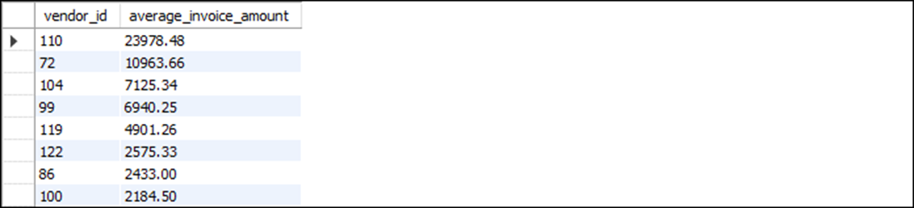
A summary query that calculates the average invoice amount by vendor
SELECT vendor_id, ROUND(AVG(invoice_total), 2) AS average_invoice_amount
FROM invoices
GROUP BY vendor_id
HAVING AVG(invoice_total) > 2000
ORDER BY average_invoice_amount DESC
(8 rows)

Slide 11
A summary query that includes a functionally dependent column
SELECT vendor_name, vendor_state,
ROUND(AVG(invoice_total), 2) AS average_invoice_amount
FROM vendors JOIN invoices
ON vendors.vendor_id = invoices.vendor_id
GROUP BY vendor_name
HAVING AVG(invoice_total) > 2000
ORDER BY average_invoice_amount DESC

Slide 12
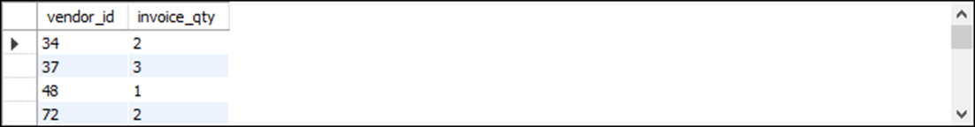
A summary query that counts the number of invoices by vendor
SELECT vendor_id, COUNT(*) AS invoice_qty
FROM invoices
GROUP BY vendor_id
(34 rows)

Slide 13
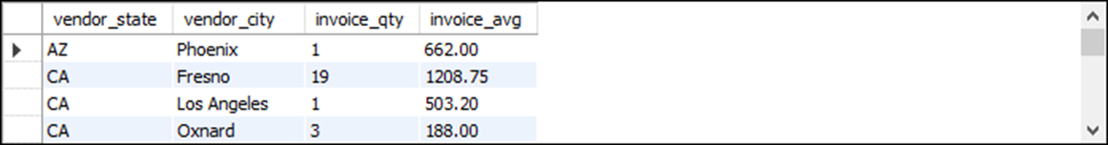
A summary query with a join
SELECT vendor_state, vendor_city, COUNT(*) AS invoice_qty,
ROUND(AVG(invoice_total), 2) AS invoice_avg
FROM invoices JOIN vendors
ON invoices.vendor_id = vendors.vendor_id
GROUP BY vendor_state, vendor_city
ORDER BY vendor_state, vendor_city
(20 rows)

Slide 14
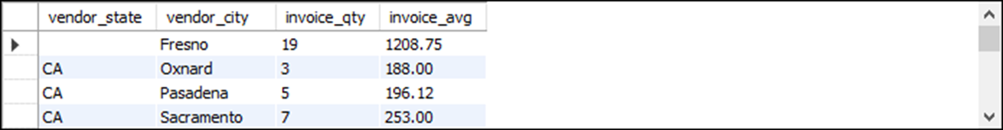
A summary query that limits the groups to those with two or more invoices
SELECT vendor_state, vendor_city, COUNT(*) AS invoice_qty,
ROUND(AVG(invoice_total), 2) AS invoice_avg
FROM invoices JOIN vendors
ON invoices.vendor_id = vendors.vendor_id
GROUP BY vendor_state, vendor_city
HAVING COUNT(*) >= 2
ORDER BY vendor_state, vendor_city
(12 rows)

Slide 15
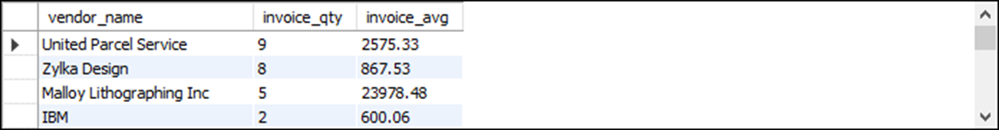
A summary query with a search condition in the HAVING clause
SELECT vendor_name,
COUNT(*) AS invoice_qty,
ROUND(AVG(invoice_total), 2) AS invoice_avg
FROM vendors JOIN invoices
ON vendors.vendor_id = invoices.vendor_id
GROUP BY vendor_name
HAVING AVG(invoice_total) > 500
ORDER BY invoice_qty DESC
(19 rows)

Slide 16
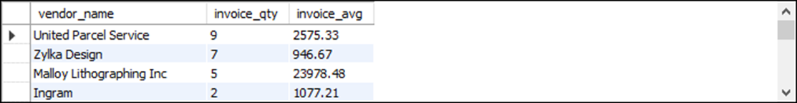
A summary query with a search condition in the WHERE clause
SELECT vendor_name,
COUNT(*) AS invoice_qty,
ROUND(AVG(invoice_total), 2) AS invoice_avg
FROM vendors JOIN invoices
ON vendors.vendor_id = invoices.vendor_id
WHERE invoice_total > 500
GROUP BY vendor_name
ORDER BY invoice_qty DESC
(20 rows)

Slide 17
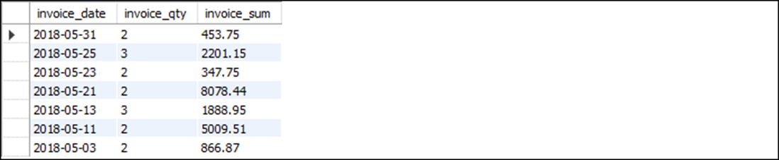
A summary query with a compound condition in the HAVING clause
SELECT
invoice_date,
COUNT(*) AS invoice_qty,
SUM(invoice_total) AS invoice_sum
FROM invoices
GROUP BY invoice_date
HAVING invoice_date BETWEEN '2018-05-01' AND '2018-05-31'
AND COUNT(*) > 1
AND SUM(invoice_total) > 100
ORDER BY invoice_date DESC
The result set
(7 rows)

Slide 18
The same query coded with a WHERE clause
SELECT
invoice_date,
COUNT(*) AS invoice_qty,
SUM(invoice_total) AS invoice_sum
FROM invoices
WHERE invoice_date BETWEEN '2018-05-01' AND '2018-05-31'
GROUP BY invoice_date
HAVING COUNT(*) > 1
AND SUM(invoice_total) > 100
ORDER BY invoice_date DESC
The same result set
(7 rows)

Slide 20
Roll Up & Window Functionality

Slide 21
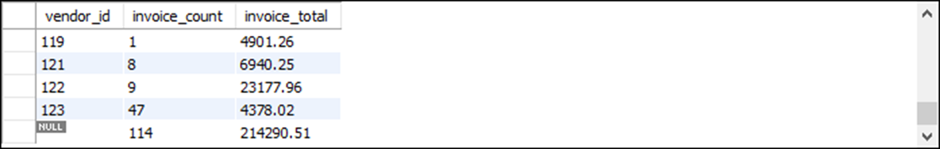
A summary query with a final summary row
SELECT vendor_id, COUNT(*) AS invoice_count,
SUM(invoice_total) AS invoice_total
FROM invoices
GROUP BY vendor_id WITH ROLLUP
(35 rows)

Slide 22
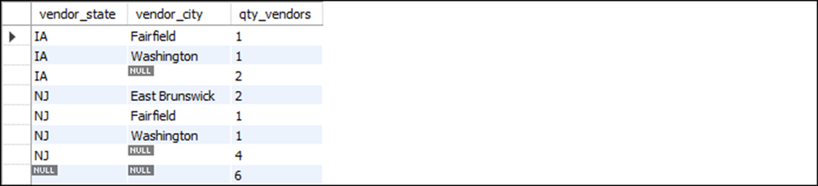
A summary query with a summary row for each grouping level
SELECT vendor_state, vendor_city, COUNT(*) AS qty_vendors
FROM vendors
WHERE vendor_state IN ('IA', 'NJ')
GROUP BY vendor_state, vendor_city WITH ROLLUP

Slide 23
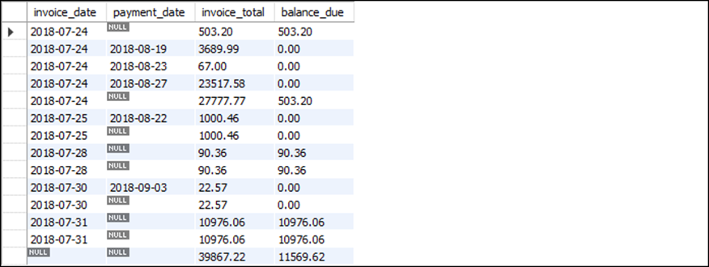
The basic syntax of the GROUPING function
GROUPING(expression)
A summary query that uses WITH ROLLUP on a table with null values
SELECT invoice_date, payment_date,
SUM(invoice_total) AS invoice_total,
SUM(invoice_total - credit_total - payment_total) AS balance_due
FROM invoices
WHERE invoice_date BETWEEN '2018-07-24' AND '2018-07-31'
GROUP BY invoice_date, payment_date WITH ROLLUP

Slide 24
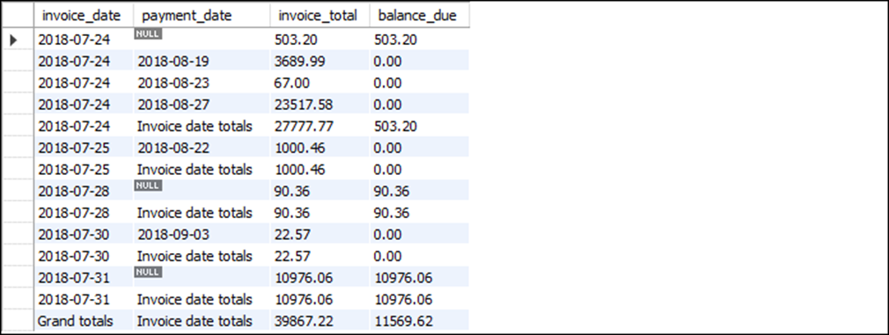
A query that substitutes literals for nulls in summary rows
SELECT IF(GROUPING(invoice_date) = 1, 'Grand totals',
invoice_date) AS invoice_date,
IF(GROUPING(payment_date) = 1, 'Invoice date totals',
payment_date) AS payment_date,
SUM(invoice_total) AS invoice_total,
SUM(invoice_total - credit_total - payment_total)
AS balance_due
FROM invoices
WHERE invoice_date BETWEEN '2018-07-24' AND '2018-07-31'
GROUP BY invoice_date, payment_date WITH ROLLUP

Slide 25
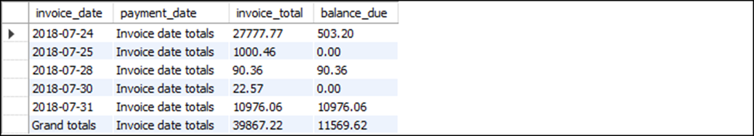
A query that displays only summary rows
SELECT IF(GROUPING(invoice_date) = 1, 'Grand totals', invoice_date)
AS invoice_date,
IF(GROUPING(payment_date) = 1, 'Invoice date totals',
payment_date) AS payment_date,
SUM(invoice_total) AS invoice_total,
SUM(invoice_total - credit_total - payment_total)
AS balance_due
FROM invoices
WHERE invoice_date BETWEEN '2018-07-24' AND '2018-07-31'
GROUP BY invoice_date, payment_date WITH ROLLUP
HAVING GROUPING(invoice_date) = 1 OR GROUPING(payment_date) = 1

Slide 26
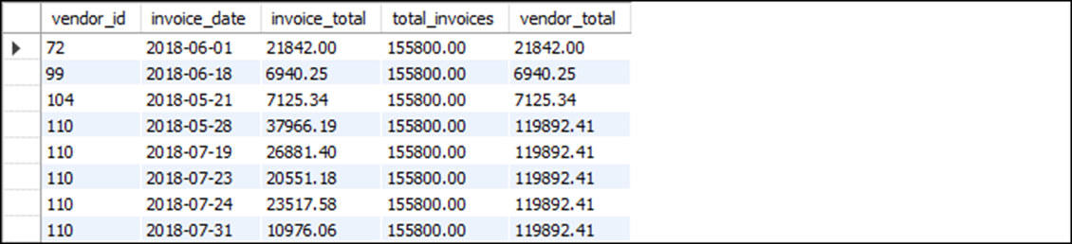
The basic syntax of the OVER clause
OVER([PARTITION BY expression1 [, expression2]...
[ORDER BY expression1 [ASC|DESC]
[, expression2 [ASC|DESC]]...)
A SELECT statement with two aggregate window functions
SELECT vendor_id, invoice_date, invoice_total,
SUM(invoice_total) OVER() AS total_invoices,
SUM(invoice_total) OVER(PARTITION BY vendor_id)
AS vendor_total
FROM invoices
WHERE invoice_total > 5000

Slide 27
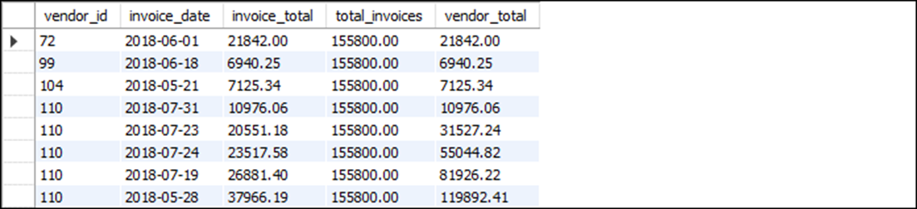
A SELECT statement with a cumulative total
SELECT vendor_id, invoice_date, invoice_total,
SUM(invoice_total) OVER() AS total_invoices,
SUM(invoice_total) OVER(PARTITION BY vendor_id
ORDER BY invoice_total) AS vendor_total
FROM invoices
WHERE invoice_total > 5000

Slide 28
The syntax for defining a frame
{ROWS | RANGE} {frame_start |
BETWEEN frame_start AND frame_end}
Possible values for frame_start and frame_end
CURRENT ROW
UNBOUNDED PRECEDING
UNBOUNDED FOLLOWING
expr PRECEDING
expr FOLLOWING

Slide 29
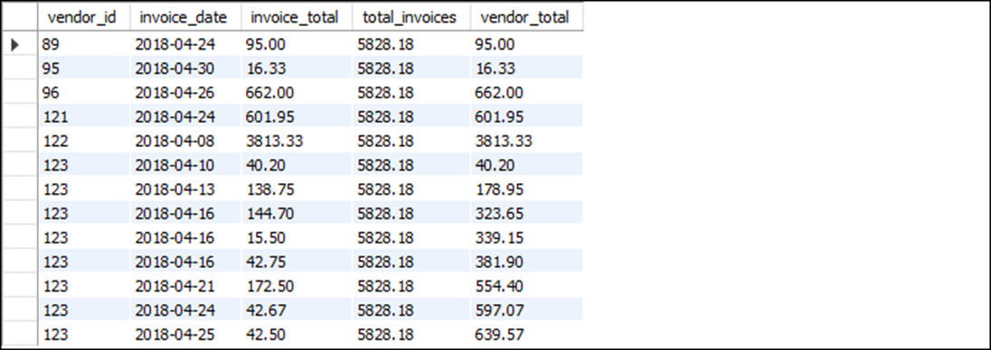
A SELECT statement that defines a frame
SELECT vendor_id, invoice_date, invoice_total,
SUM(invoice_total) OVER() AS total_invoices,
SUM(invoice_total) OVER(PARTITION BY vendor_id
ORDER BY invoice_date
ROWS BETWEEN UNBOUNDED PRECEDING AND CURRENT ROW)
AS vendor_total
FROM invoices
WHERE invoice_date BETWEEN '2018-04-01' AND '2018-04-30'

Slide 30
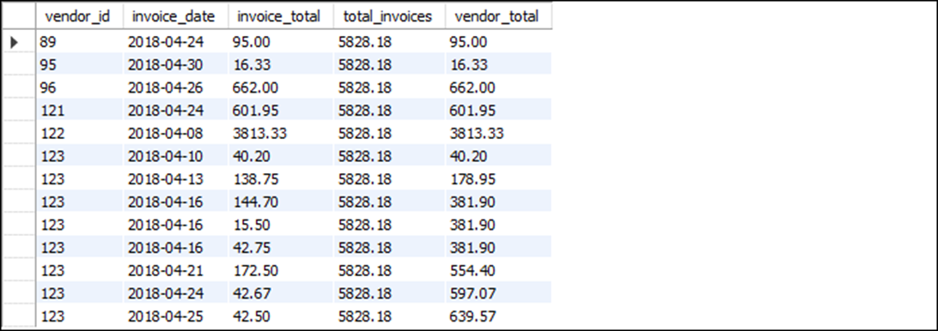
A SELECT statement that creates peer groups
SELECT vendor_id, invoice_date, invoice_total,
SUM(invoice_total) OVER() AS total_invoices,
SUM(invoice_total) OVER(PARTITION BY vendor_id
ORDER BY invoice_date
RANGE BETWEEN UNBOUNDED PRECEDING AND CURRENT ROW)
AS vendor_total
FROM invoices
WHERE invoice_date BETWEEN '2018-04-01' AND '2018-04-30'

Slide 31
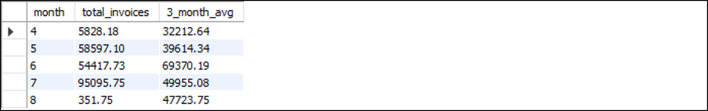
A SELECT statement that calculates moving averages
SELECT MONTH(invoice_date) AS month,
SUM(invoice_total) AS total_invoices,
ROUND(AVG(SUM(invoice_total))
OVER(ORDER BY MONTH(invoice_date)
RANGE BETWEEN 1 PRECEDING AND 1 FOLLOWING), 2)
AS 3_month_avg
FROM invoices
GROUP BY MONTH(invoice_date)

Slide 32
The syntax for naming a window
WINDOW window_name AS
([partition_clause] [order_clause] [frame_clause])

Slide 33
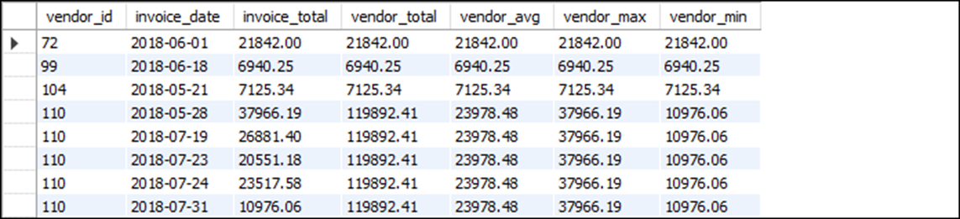
A SELECT statement with four functions that use the same window
SELECT vendor_id, invoice_date, invoice_total,
SUM(invoice_total) OVER(PARTITION BY vendor_id)
AS vendor_total,
ROUND(AVG(invoice_total) OVER(PARTITION BY vendor_id), 2)
AS vendor_avg,
MAX(invoice_total) OVER(PARTITION BY vendor_id)
AS vendor_max,
MIN(invoice_total) OVER(PARTITION BY vendor_id)
AS vendor_min
FROM invoices
WHERE invoice_total > 5000
The result set

Slide 34
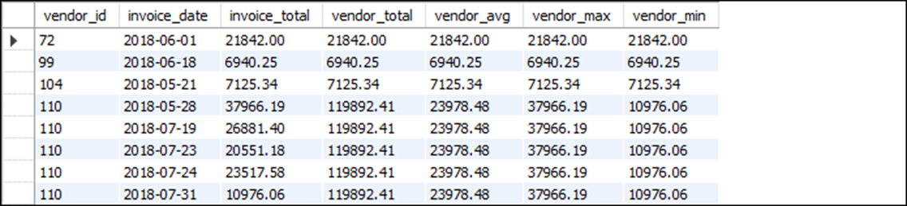
A SELECT statement with a named window
SELECT vendor_id, invoice_date, invoice_total,
SUM(invoice_total) OVER vendor_window
AS vendor_total,
ROUND(AVG(invoice_total) OVER vendor_window, 2)
AS vendor_avg,
MAX(invoice_total) OVER vendor_window AS vendor_max,
MIN(invoice_total) OVER vendor_window AS vendor_min
FROM invoices
WHERE invoice_total > 5000
WINDOW vendor_window AS (PARTITION BY vendor_id)
The same result set

Slide 35
A SELECT statement that adds to the specification for a named window
SELECT vendor_id, invoice_date, invoice_total,
SUM(invoice_total)
OVER (vendor_window ORDER BY
invoice_date ASC)
AS invoice_date_asc,
SUM(invoice_total)
OVER (vendor_window ORDER BY
invoice_date DESC)
AS invoice_date_desc
FROM invoices
WHERE invoice_total > 5000
WINDOW vendor_window AS (PARTITION BY
vendor_id)

